Slide 1
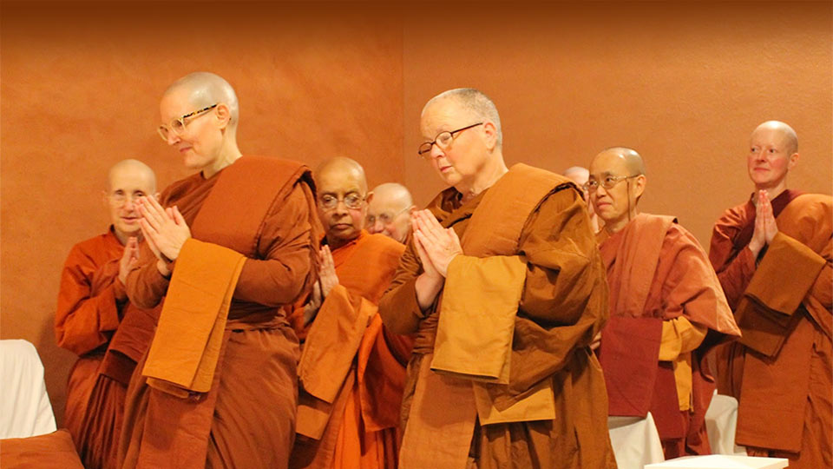
www.bhikkhuni.net | facebook.com/AllianceforBhikkhunis

Slide 2
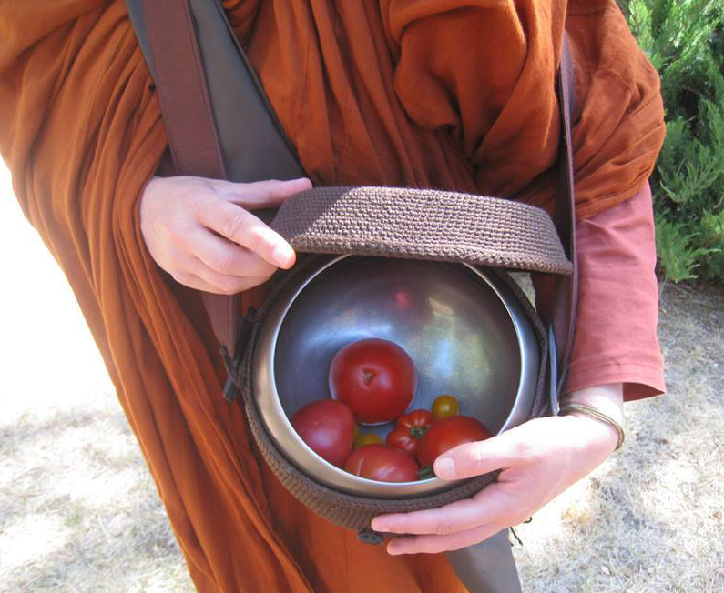
What We Do
Raise funds for the basic needs of Theravada Bhikkhunis:
Food
Clothing
Shelter
Health Care

Slide 3
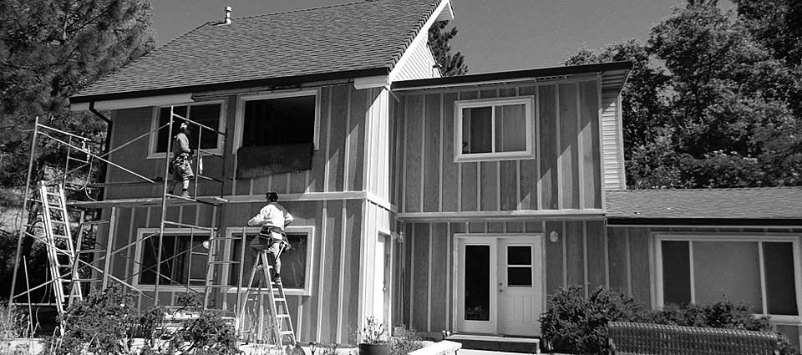
Our Mission
Supporting Monastery Development

Slide 4
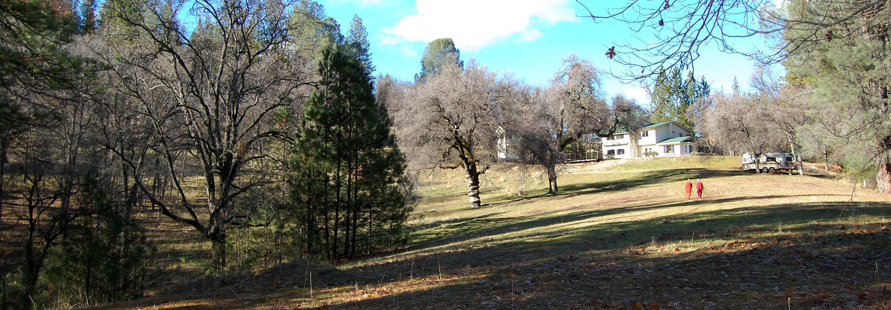
Donations To Aloka Vihara
AfB contributed to the purchase of property for Aloka Vihara

Slide 5
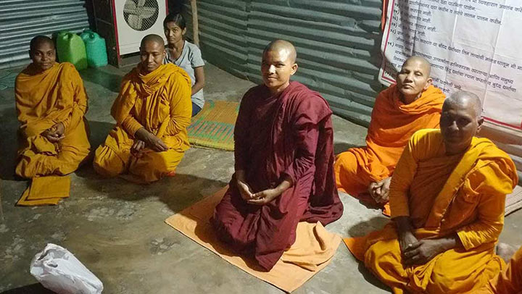
Funds for Nuns in Nagpur, India
Adhimutti Bhikkhuni visited these nuns living in poverty in Nagpur, India. Through her efforts and donations from AfB and Dhammadharini, she purchased coolers, mattresses and arranged for a power line to be connected. New robes were also presented.

Slide 6
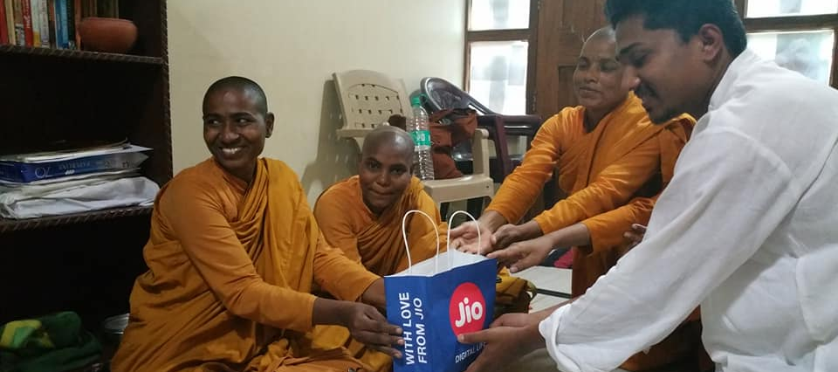
Contributions to Nuns in Nagpur, India

Slide 7
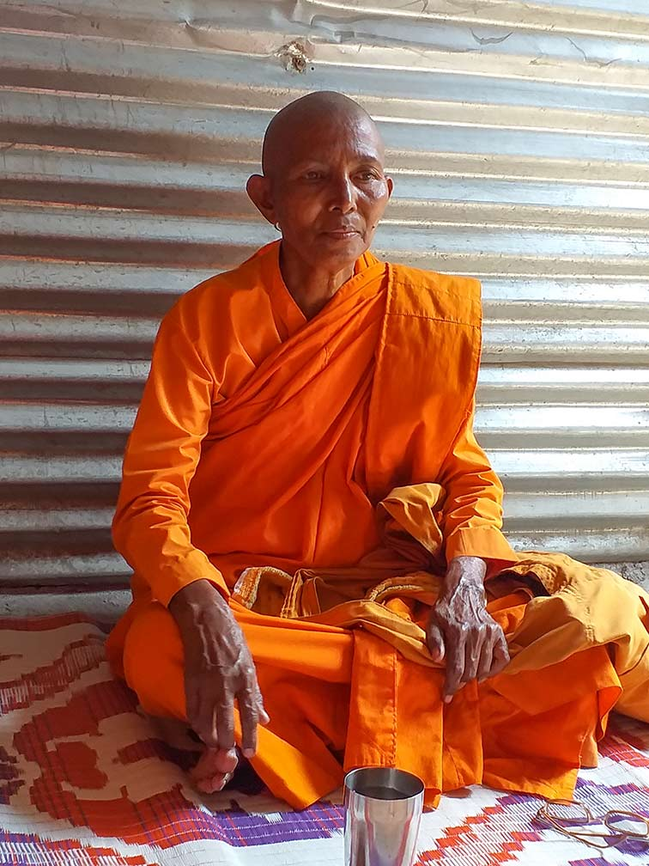
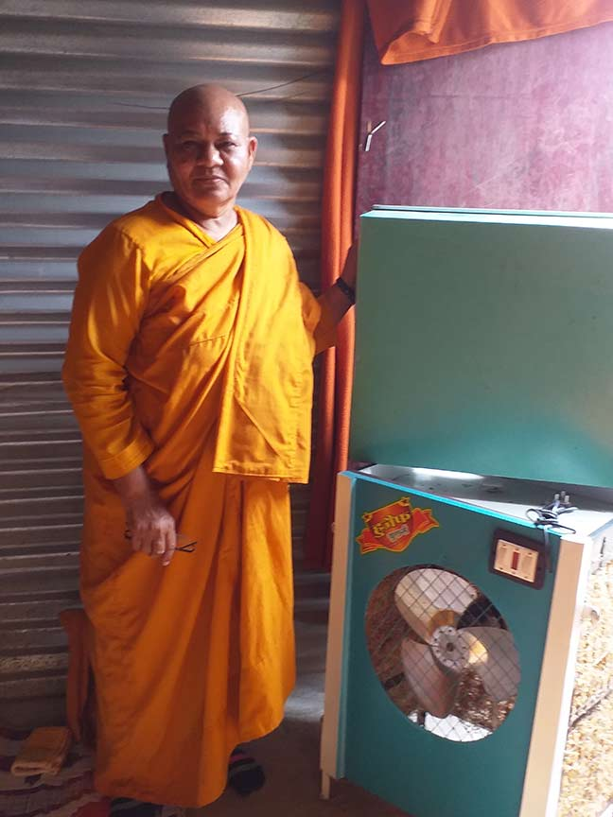
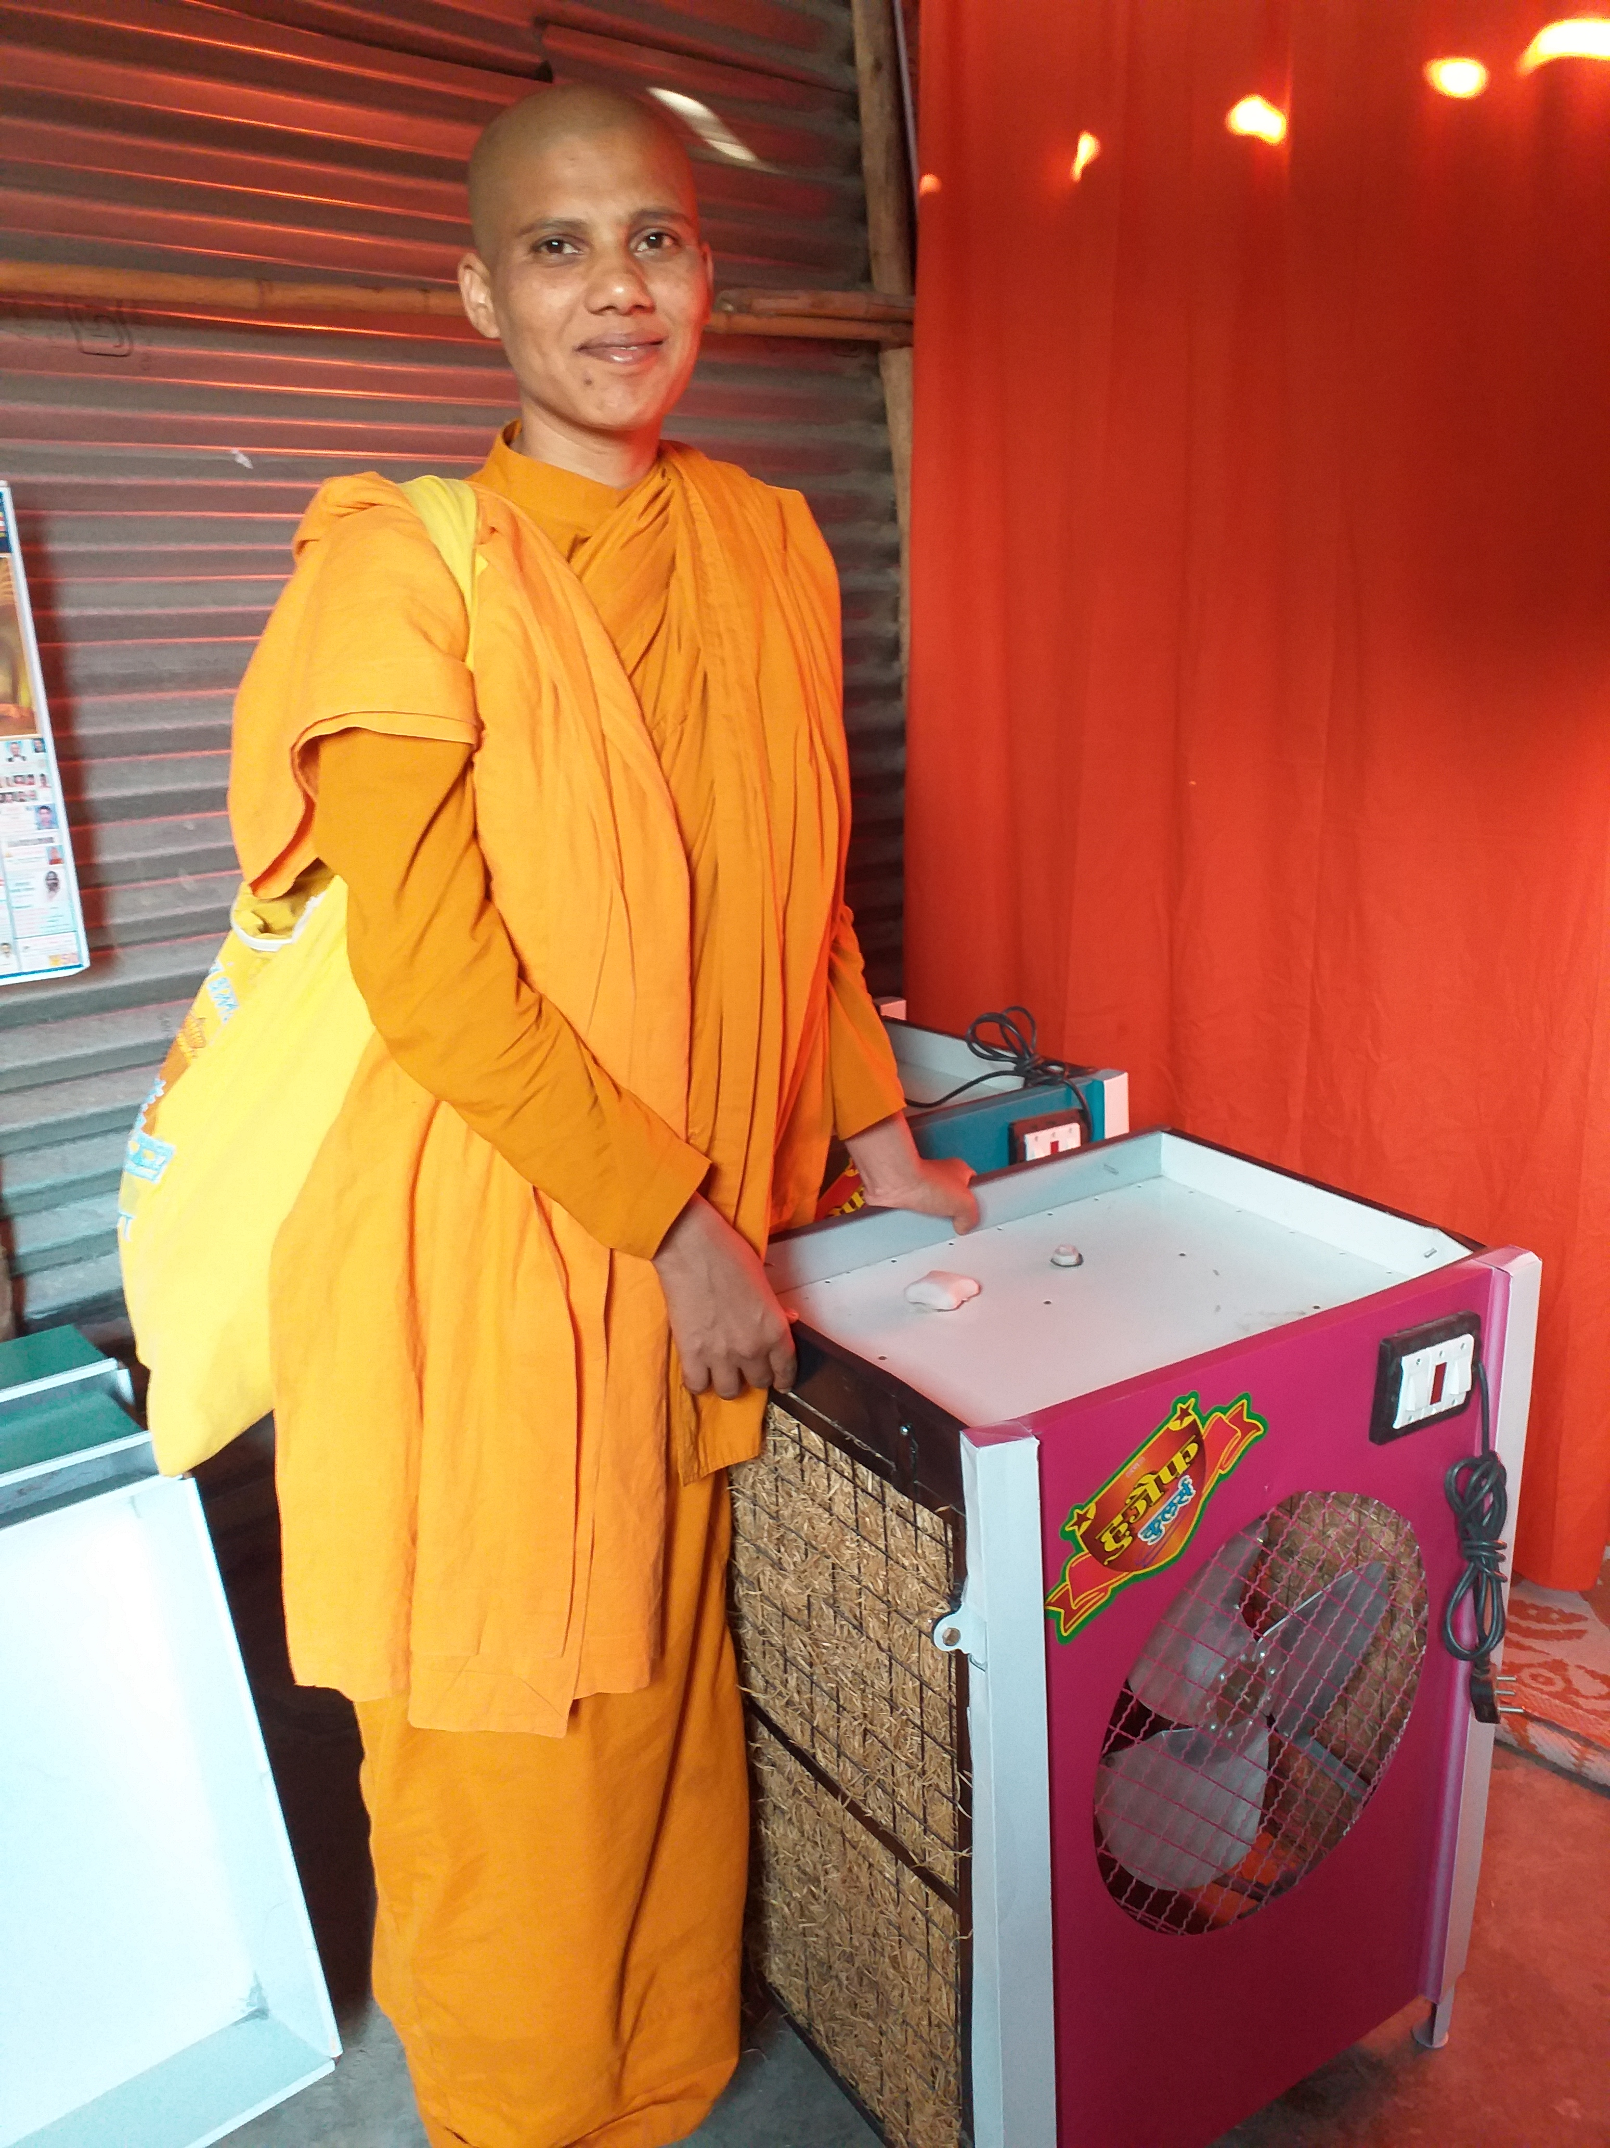
Nuns in Nagpur, India

Slide 8
Funds to Karuna Sevena, Czech Republic
AfB contributed towards roof repair

Slide 9
Donations to Dhammadharini
AfB donated funds to the new Dhammadharini monastery property in Penngrove, CA.

Slide 10
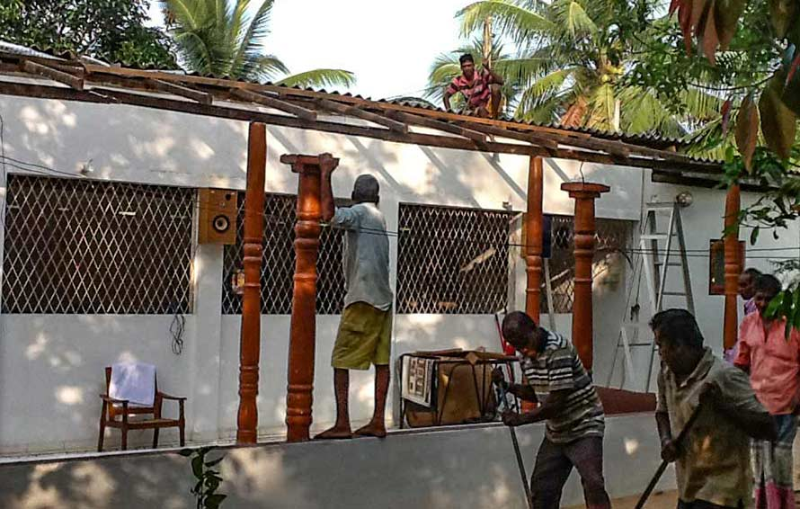
Funds to Aramaya
in Sri Lanka
AfB has contributed to the reconstruction of the meditation hall and lodgings at Padduka Mathika Matha Bhikkhuni Aramaya in Sri Lanka.

Slide 11
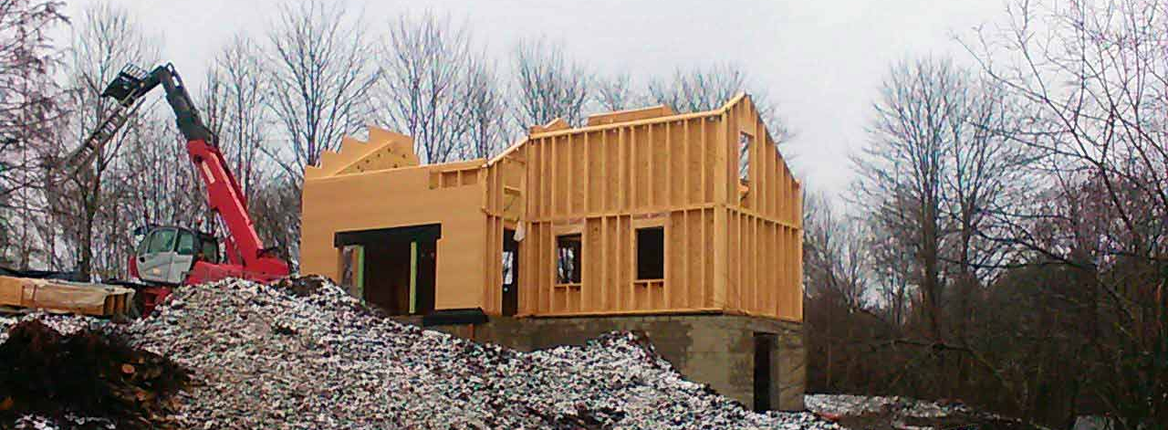
Contributions to Tilorien Monastery, Belgium
AfB contributed funds for the construction of the monastery and kutis

Slide 12
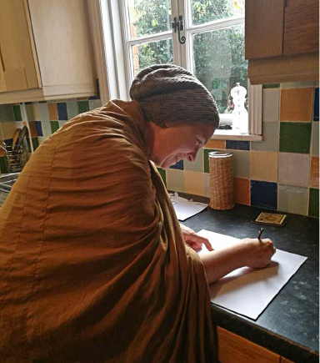
Contributions to Anukampa, Great Britain
AfB has contributed towards the first bhikkhuni residence in Great Britain. Here, Bhikkhuni Canda signs a lease on a three bedroom property in Oxford.

Slide 13
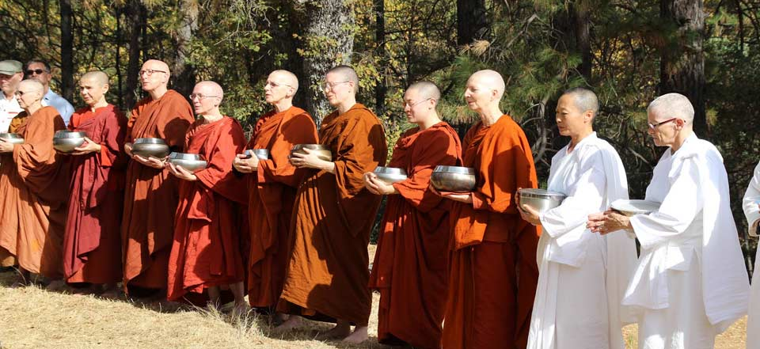
Our Mission
Growing the Bhikkhuni Sangha

Slide 14
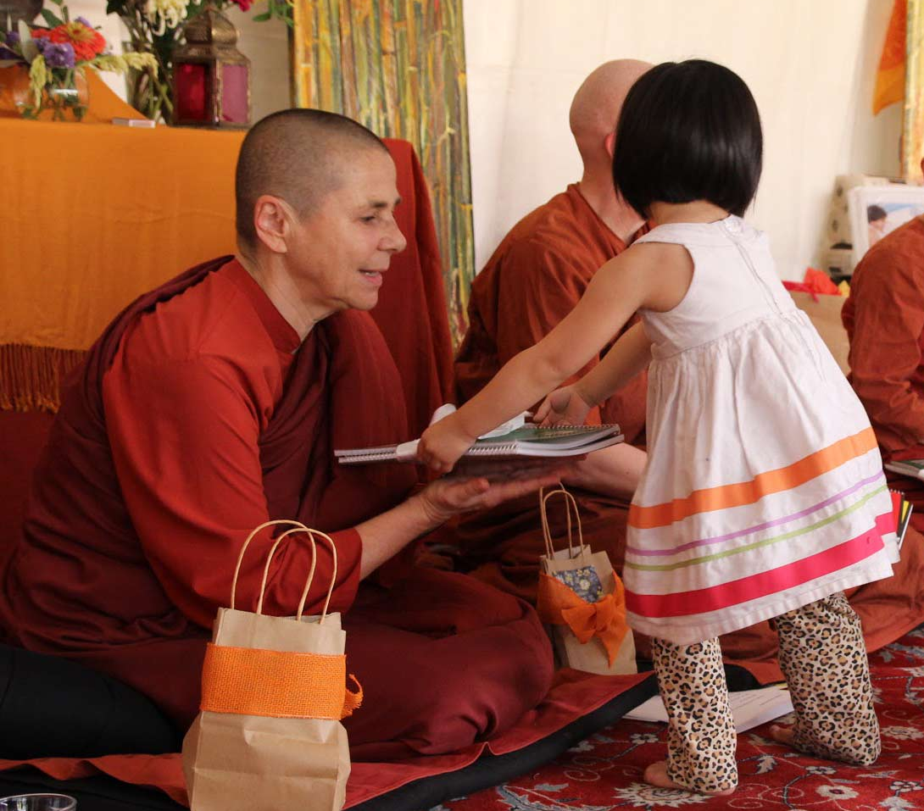
What We Do
Support ordinations
Support travel to ordinations, conferences and meetings
Support bhikkhuni retreats

Slide 15
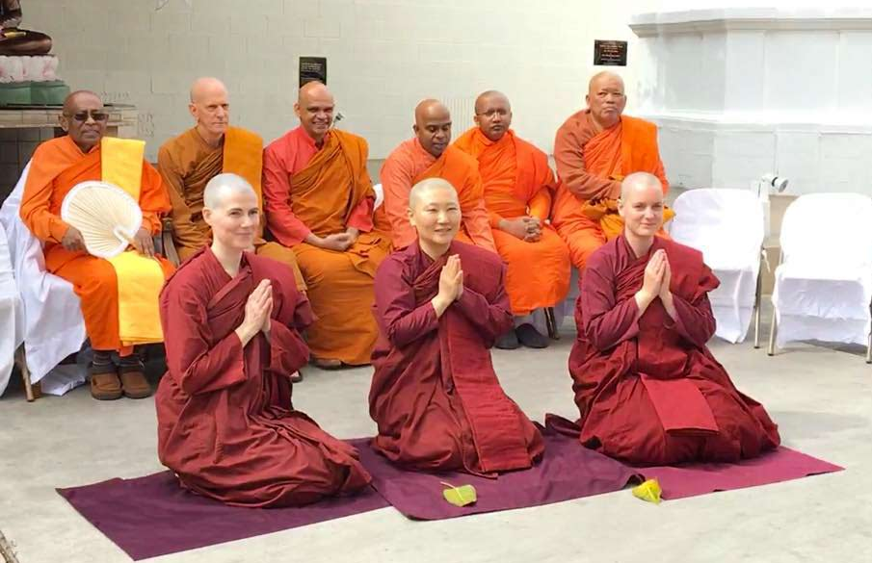
2018
Ordinations
AfB contributed to the ordinations of three new bhikkhunis in North America! Ven Bhikkhuni Vimalanyani, Ven Bhikkhuni Kosala Vipassini, and Ven Bhikkhuni Pārāyanā Sirī all received Bhikkhuni Upasampada (full ordination) in March 2018.

Slide 16
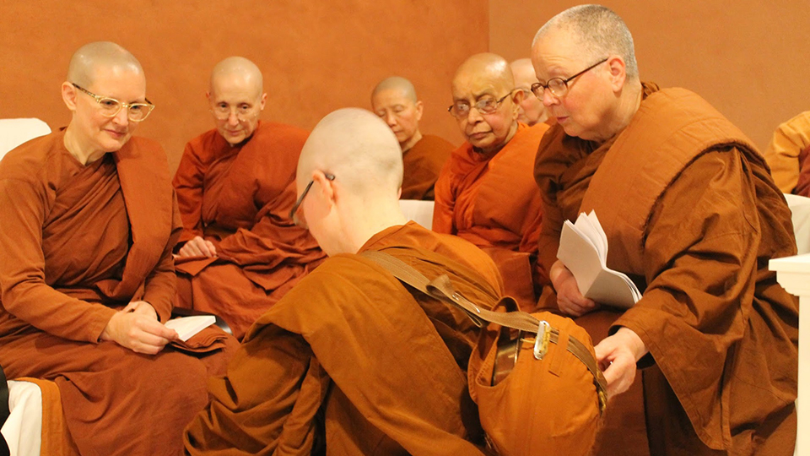
AfB contributed towards the 2017 ordinations of Samaneri Anuruddha and Samaneri Niyyanika

Slide 17
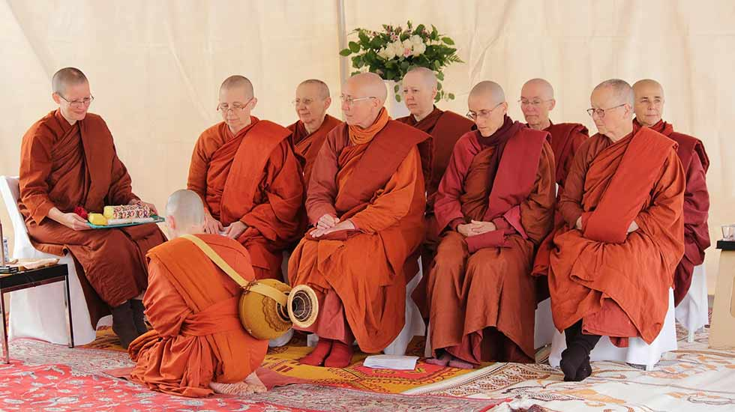
AfB contributed towards ordination of Ayya Jayati in 2014

Slide 18
Our Mission
Supporting Travel to Ordinations, Conferences and Retreats

Slide 19
AfB Travel Support
AfB supported Bhikkhuni Canda’s visit to Aloka Vihara in 2016
Bhikkhuni Canda writes, “May I again thank you for the support you were able to give to me personally, i.e., my return flight to California this year. The journey came at a pivotal time on my path and provided me the much needed and sustaining sense of being part of a global sangha.”

Slide 20
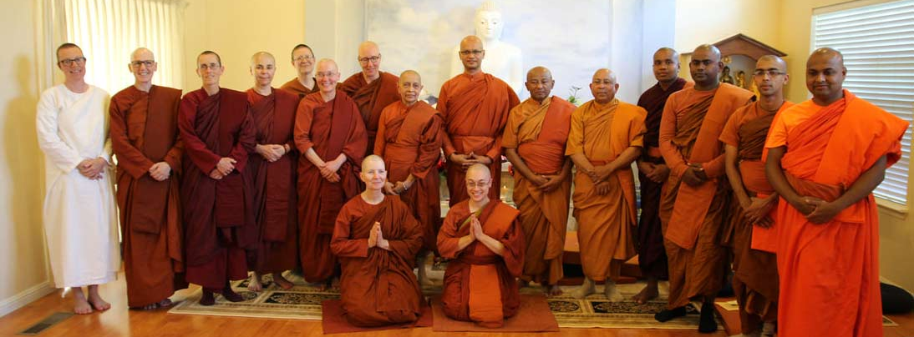
Ordination of Bhikkhuni Cittananda and Samaneri Dhammadipa
AfB contributed funds towards transportation costs for this ordination in 2018

Slide 21
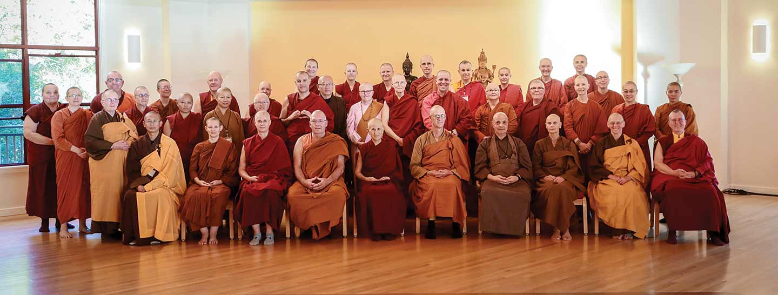
Travel to the Western Buddhist Monastic Gathering
AfB contributed funds for nuns to travel to the Western Buddhist Monastic Gathering in 2018

Slide 22
Our Mission
Supporting Bhikkhuni Health
AfB’s medical fund has supported bhikkhunis’ health insurance, dental work and other important health essentials.

Slide 23
Bhikkhuni Visuddhi
Karuna Sevena, Czech Republic
“I want to thank you once again for providing me financial help and support. With all the politics around bhikkhunis in the world and lack of support we have, I appreciate even more those people who see us and are willing to support and help us.”

Slide 24
Bhikkhuni Cittananda
Karuna Buddhist Vihara, CA
“I really appreciate the help you’ve given all the bhikkhunis over the years. Since so many of us have so little safety net, your generosity has proven invaluable — both materially and as peace of mind that many people actually do support what we're doing with our lives. Anumodana!”

Slide 25
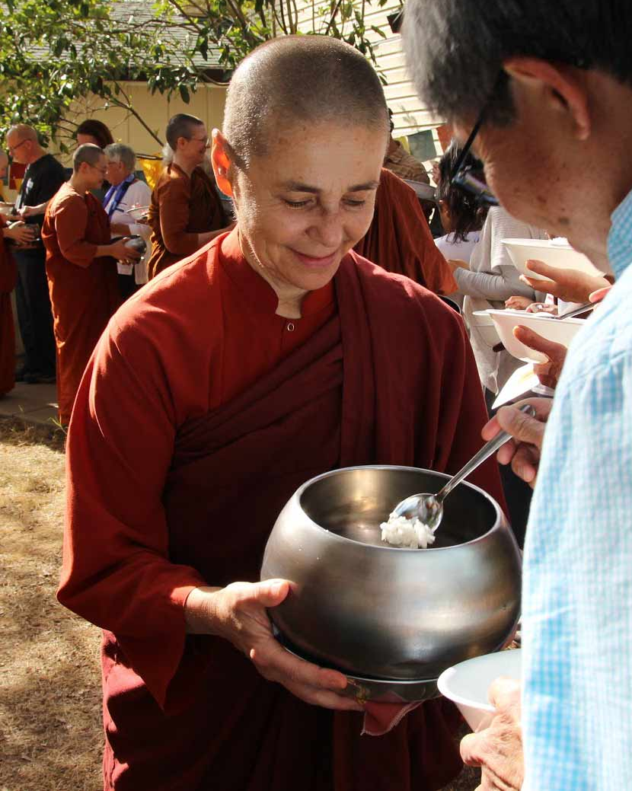
The Gift of Dana
The practice of giving is universally recognized as one of the most basic human virtues, a quality that testifies to the depth of one’s humanity and one’s capacity for self-transcendence.
- Bhikkhu Bodhi
Contribute to AfB!
bhikkhuni.net/dana-offerings/

